Slide 1
Data Warehousing and Business Intelligence
-Saish, Krutika, Gurleen

Slide 2
Steps towards loading the Data warehouse
Loading all the sources into the multiple databases
Loaded all dimensions which are independent of other dimensions
Loading the dependent dimensions
Loading the Fact Tables
Creating the system of records table to identify the sorces
Creating Data model and generating Talend Documentation
Export the warehouse and create visualizations

Slide 3
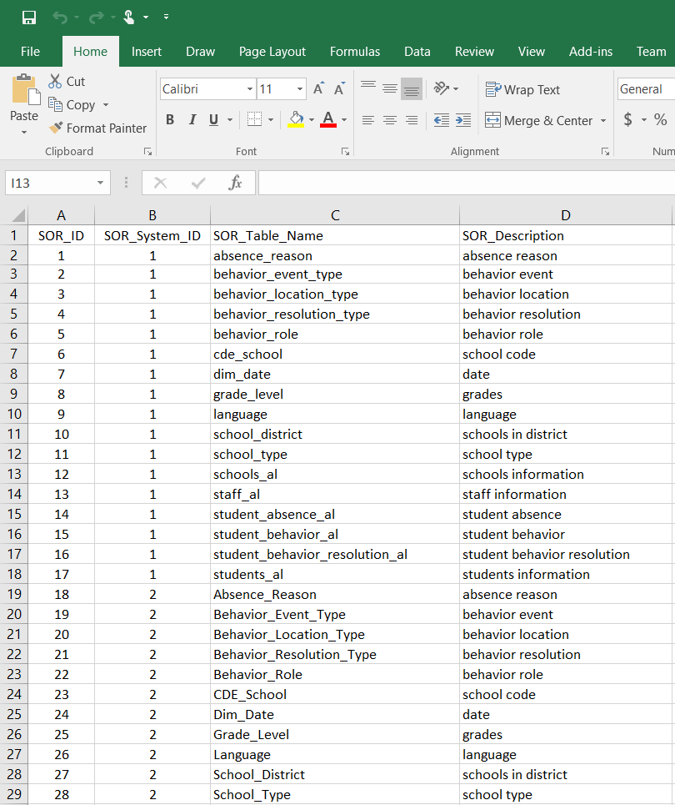
SOR Table listing all the databases and tables(92 tables)

Slide 4
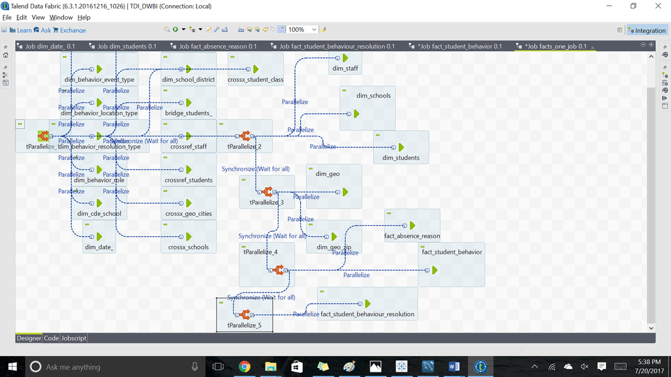
Parallelized job

Slide 5
Points to remember
Running jobs in talend consumes a lot of time and has to be planned ahead.
Loading data in the BI tools and clearing the synthetic key dependencies is time consuming.
SOR ID’s have to implemented initially.
We can better handle the rejects after completing the project.

Slide 6
Thank You ☺

